Slide 1
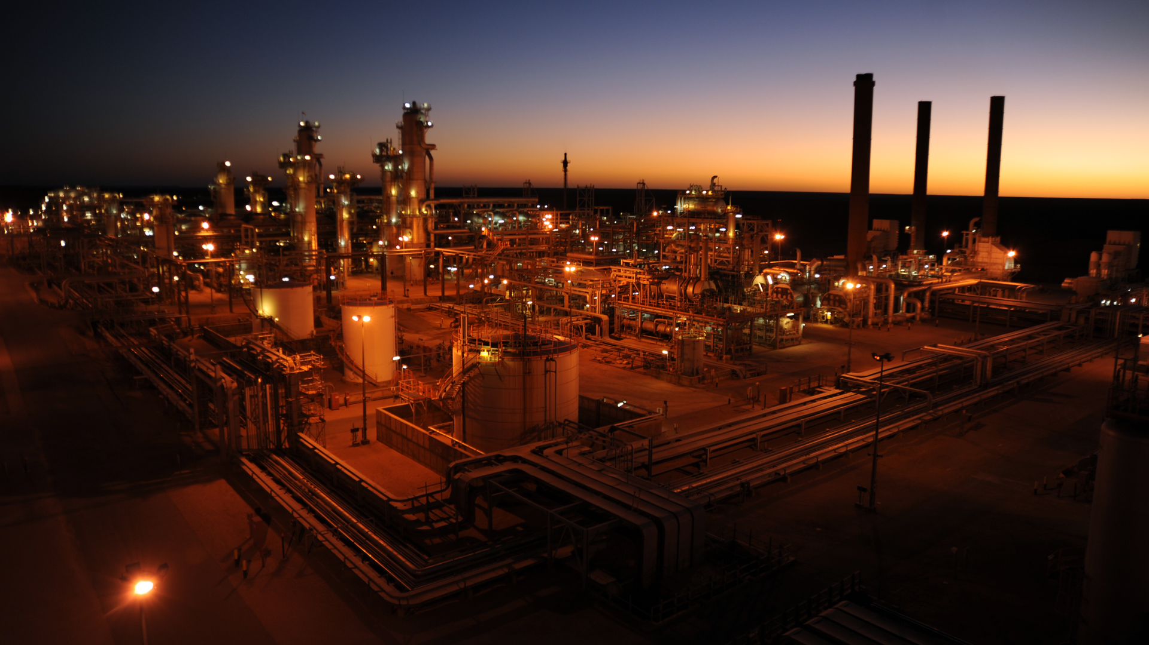
Username
Password
Login
Forget my password

Slide 2





Ongoing projects
Completed projects
Critical Task List
User List
Options
. . .
Ongoing Projects
Code
Project Name
Project Zone
Progress
BRH1802
33/11kV GIS New Substation at Burirhat
Lalbagh, Rangpur
48.57%
LBG1806
33/11kV GIS New Substation at Lalbag
Burirhat, Rangpur
13.77%
SUN1807
33/11kV GIS New Substation at Sunamganj
Sunamganj, Rangpur
0.00%
KDM1803
33/11kV GIS New Substation at Khadim
Khadim, Rangpur
87.77%

Slide 3
Ongoing projects
Completed projects
Critical Task List
User List
Options
. . .
Ongoing Projects: BRH1802
Code
Project Name
Project Zone
Progress
BRH1802
33/11kV GIS New Substation at Burirhat
Burirhat, Rangpur
48.57%
Design
Procurement
Logistics
Construction
Installation, Testing & Commissioning
Finance
13.77%
87.77%
25.73%
35.73%
0.00%
0.00%

Slide 4

Ongoing projects
Completed projects
Critical Task List
User List
Options
. . .
Ongoing Projects: BRH1802
Code
Project Name
Project Zone
Progress
BRH1802
33/11kV GIS New Substation at Burirhat
Burirhat, Rangpur
43.77 %
Design
13.77 %
SL
Task Description
Starting Date
Ending Date
Progress
1
- 33 kV GIS
1.1
- 33kV incoming feeder panel
1.1.1
Line isolator
1.1.2
Line Circuit Breaker
1.1.3
Line CT
1.1.4
CB
1.2
+ BUS coupler panel
1.3
Transformer Outgoing
Tasks with subtasks
Expand View details
Tasks without Subtasks
View Details Update status Upload file View files
Subtasks with sub-subtasks
Expand
Subtasks without sub-subtasks
Update Status Upload file View files
All Sub-subtasks
Update Status Upload file View file

Slide 5
Ongoing projects
Completed projects
Critical Task List
User List
Options
. . .
Ongoing Projects: BRH1802
Code
Project Name
Project Zone
Progress
BRH1802
33/11kV GIS New Substation at Burirhat
Burirhat, Rangpur
43.77 %
Design
13.77 %
Task tree
Status
-
13.77 %
1
33 kV GIS
1.1
-
33kV incoming feeder panel
63.77 %
1.1.1
Line isolator
89.77 %
1.1.2
clickable
Line Circuit Breaker
26.77 %
1.1.3
Line CT
100.00 %
1.1.4
CB
+
35.77 %
1.2
BUS coupler panel
1.3
Transformer Outgoing
35.77 %
Remarks
Files
Single Line Diagram (SLD)
Overall Layout Drawing
Architectural Drawing
View or download
Request for delete

Slide 6
Ongoing projects
Completed projects
Critical Task List
User List
Options
. . .
Ongoing Projects: BRH1802
Code
Project Name
Project Zone
Progress
BRH1802
33/11kV GIS New Substation at Burirhat
Burirhat, Rangpur
43.77 %
Design
13.77 %
Task tree
Status
-
13.77 %
1
33 kV GIS
1.1
-
33kV incoming feeder panel
63.77 %
1.1.1
Line isolator
89.77 %
1.1.2
clickable
Line Circuit Breaker
26.77 %
1.1.3
Line CT
100.00 %
1.1.4
CB
+
35.77 %
1.2
BUS coupler panel
1.3
Transformer Outgoing
35.77 %
Remarks
Files
Single Line Diagram (SLD)
Overall Layout Drawing
One file not showing, as it was
From another subtasks

Slide 7
Ongoing projects
Completed projects
Critical Task List
User List
Options
. . .
Ongoing Projects: BRH1802
Code
Project Name
Project Zone
Progress
BRH1802
33/11kV GIS New Substation at Burirhat
Burirhat, Rangpur
43.77 %
Design
13.77 %
Task tree
Status
-
13.77 %
Request for reset
1
33 kV GIS
Submit to PD office
1.1
-
33kV incoming feeder panel
63.77 %
1.1.1
Line isolator
89.77 %
Forward to Design Department Three
1.1.2
clickable
Line Circuit Breaker
Forward to PD office from DD3
1.1.3
Line CT
26.77 %
Forward to Design Department Two
1.1.4
CB
100.00 %
Forward to PD office from DD2
+
35.77 %
Receive Approved Drawing from PD Office
1.2
BUS coupler panel
1.3
Transformer Outgoing
35.77 %
Mark as Complete
Remarks
Files
We faced lot of issues to solve it, as client was found non supporting
Single Line Diagram (SLD)
Only the file that is uploaded
Against this bottom layer, shown here.

Slide 8

My Profile: John Doe
John Doe
John Doe Milestone
Assistant Engineer (EEE)
Phone: +88 01758 151501
Email: jdoe.heec@gmail.com
Tasks
Code
Assigned Project
Department
Role
LBG1801
Design, Supply, Installation, Testing Commissioning of a new 33/11 KV…
Design
Moderator
LBG1801
Design, Supply, Installation, Testing Commissioning of a new 33/11 KV…
- - -
Project Manager
LBG1801
Design, Supply, Installation, Testing Commissioning of a new 33/11 KV…
Design
Moderator
LBG1801
Design, Supply, Installation, Testing Commissioning of a new 33/11 KV…
Design
Moderator

Slide 9
User Profile: John Doe
John Doe
Assistant Engineer (EEE)
Phone: +88 01758 151501
Email: jdoe.heec@gmail.com
Tasks
Code
Assigned Project
Department
Role
LBG1801
Design, Supply, Installation, Testing Commissioning of a new 33/11 KV…
Design
Moderator
LBG1801
Design, Supply, Installation, Testing Commissioning of a new 33/11 KV…
- - -
Project Manager
LBG1801
Design, Supply, Installation, Testing Commissioning of a new 33/11 KV…
Design
Moderator
LBG1801
Design, Supply, Installation, Testing Commissioning of a new 33/11 KV…
Design
Moderator

Slide 10
Ongoing projects
Completed projects
Critical Task List
User List
Options
. . .
Completed Projects
Code
Project Name
Project Zone
Progress
BRH1802
33/11kV GIS New Substation at Burirhat
Lalbagh, Rangpur
100.00 %
LBG1806
33/11kV GIS New Substation at Lalbag
Burirhat, Rangpur
100.00 %
SUN1807
33/11kV GIS New Substation at Sunamganj
Sunamganj, Rangpur
100.00 %
KDM1803
33/11kV GIS New Substation at Khadim
Khadim, Rangpur
100.00 %

Slide 11
Ongoing projects
Completed projects
Critical Task List
User List
Options
. . .
Completed Projects: BRH1802
Code
Project Name
Project Zone
Progress
BRH1002
33/11kV GIS New Substation at Burirhat
Burirhat, Rangpur
100.00 %
Design
Procurement
Logistics
Construction
Installation, Testing & Commissioning
Finance
100.00 %
100.00 %
100.00 %
100.00 %
100.00 %
100.00 %

Slide 12
Ongoing projects
Completed projects
Critical Task List
User List
Options
. . .
Completed Projects: BRH1802
Code
Project Name
Project Zone
Progress
BRH1002
33/11kV GIS New Substation at Burirhat
Burirhat, Rangpur
100.00 %
Design
100.00 %
SL
Task Description
Starting Date
Ending Date
Progress
1
- 33 kV GIS
1.1
- 33kV incoming feeder panel
1.1.1
Line isolator
1.1.2
Line Circuit Breaker
1.1.3
Line CT
1.1.4
CB
1.2
+ BUS coupler panel
1.3
Transformer Outgoing

Slide 13
Ongoing projects
Completed projects
Critical Task List
User List
Options
. . .
Completed Projects: BRH1802
Code
Project Name
Project Zone
Progress
BRH1002
33/11kV GIS New Substation at Burirhat
Burirhat, Rangpur
100.00 %
Design
100.00 %
Task tree
Status
-
100.00 %
1
33 kV GIS
Submit to PD office
1.1
-
33kV incoming feeder panel
100.00 %
1.1.1
Line isolator
100.00 %
Forward to Design Department Three
1.1.2
clickable
Line Circuit Breaker
Forward to PD office from DD3
1.1.3
Line CT
100.00 %
Forward to Design Department Two
1.1.4
CB
100.00 %
Forward to PD office from DD2
+
100.00 %
Receive Approved Drawing from PD Office
1.2
BUS coupler panel
1.3
Transformer Outgoing
100.00 %
Remarks
Files
We faced lot of issues to solve it, as client was found non supporting
Single Line Diagram (SLD)
View or download

Slide 14
My Profile
Ongoing projects
Completed projects
Critical Task List
User List
Options
Log out
. . .
Critical Tasks
Code
Project Name
Department
Critical Task Tree
Pending Status
Risk Level
BRH1802
33/11kV GIS New Substation at Burirhat
Installation, Testing & Commissioning
33kV GIS / Subtask for 33kV GIS / Layer 2 Subtask for 33kV GIS
Submit to PD office from DD3
Very High
BRH1002
33/11kV GIS New Substation at Burirhat
Installation, Testing & Commissioning
33kV GIS / Subtask for 33kV GIS / Layer 2 Subtask for 33kV GIS
Submit to PD office from DD3
Very High
BRH1002
33/11kV GIS New Substation at Burirhat
Installation, Testing & Commissioning
33kV GIS / Subtask for 33kV GIS / Layer 2 Subtask for 33kV GIS
Submit to PD office from DD3
High
BRH1002
33/11kV GIS New Substation at Burirhat
Installation, Testing & Commissioning
33kV GIS / Subtask for 33kV GIS / Layer 2 Subtask for 33kV GIS
Submit to PD office from DD3
High

